Slide 1
Data-driven
Marketing Playbook Template
[ Insert Company Name ]

Slide 2

Welcome!
This playbook is here to get you up to speed with working at the high-performance, lightning fast, well-oiled marketing engine at [ INSERT YOUR COMPANY ]. Here, we’ve documented a plan that sets the standards for cross-team collaboration, strategic alignment, and campaign execution.
This is not a set of rules, but rather a collection of tips, tricks, and lessons we’ve learned the hard way during our journey at the company. Take them with a grain of salt and make them your own—it’s the end result that matters.
Mikko Honkanen CMO

Slide 3
Table of contents
Marketing mission
Objective and strategy
Our team
Global marketing engine
Objectives
Routines
Brand consistency
Our tech stack
Our offering
Our audience
Real-Time Marketing: Our strategies and tactics
Sales and marketing alignment
Resources

Slide 4
Our marketing team
The overall purpose for marketing at [ company name ] is simple: to maximize the amount of revenue generated by the company through marketing tactics.
[ Write the one clear objective for the the marketing at your company ]

Slide 5
Your role
[ Write the job description of a marketing specialist at your company. This will set clear responsibilities and goals. For example, the below describes the role of a Content Marketing Manager at Vainu. ]
You will work closely with your colleagues in sales and product development to create inspiring stories and articles on B2B sales and marketing.
You’ll be responsible for our content strategy and become the voice of the company.
You’ll streamline content creation by assigning work, setting deadlines, and managing our team of freelance writers and creators.

Slide 6
Our team
[ Insert organizational chart. ]
Global Marketing Team
Team members Role of the department
Local Marketing Team
Team members Role of the department
Marketing Ops Team
Team members Role of the department
Marketing department

Slide 7
Global marketing engine
The marketing team strives to organize according to an “ideal setup”, i.e. a team structure that, when fully fleshed out and with the teams performing, is well equipped to hit the objectives set.
[ Your marketing team’s structure and organization ]

Slide 8
Marketing disciplines
[ Explain here the main marketing activities to achieve your goals. ]
Operations and analytics
Communications
Paid acquisition
Provides full transparency into how different marketing efforts are impacting our bottom line across all business units.
Manages the flow of information and provides exposure to our audiences on topics of public interest where we have expertise.
Runs paid campaigns across channels to acquire new customers, with a positive ROI.
Lifecycle nurturing
Customer
evangelism
Website
Conversion
Successfully converts website traffic into revenue—as much of it as possible.
Creates drip campaigns to nurture leads towards conversion.
Facilitates happy customers turning into fans that actively promote us across all channels.
Product marketing
Content marketing
Optimizes offered products and pricing to maximize revenue.
Consistently creates the right resources for each stage of the funnel to help contacts move forward in the sales process.

Slide 9
Objectives and strategies
[ Write the common values that make your company thrive. ]
To accomplish the goal of maximizing revenue, we incorporate two overall approaches:
1. Methodically maintaining and developing the overall 'marketing engine': the brand, marketing database, assets, and processes that result in inbound leads or support the overall business objectives over time.
2. Using the marketing engine to maximize the output of leads and revenue in any given timeframe, but not at the expense of the engine's long-term output.

Slide 10

Routines
[ List your day-to-day activities and main routines. ]
Monthly reporting on key metrics: revenue, demo requests / no-touch signups, new contacts, website traffic.
Continuously optimizing the website for relevant keywords in search engines.
Producing new case studies as sourced by Customer Success.
Educating our customer base on updates to our product offering.
Routinely sharing new content: newsletter, blog posts, downloadable resources etc.
Routinely updating existing content to keep it relevant and boost SEO.
Uphold behavior-based automated email workflows for both prospects and customers.
Share different content types across our social media channels.
Run campaigns to get into other people’s channels.
Run paid ad campaigns where it has a positive ROI.
Support internal stakeholders with how to communicate effectively and correctly.
Localize communications to best serve our local markets.

Slide 11

Brand consistency
[ Your tone and voice. Ensure brand guidelines and your content style guide are clear. ]
When it comes to building a memorable brand, it’s all about consistency. Giving the audience a consistent experience builds loyalty and trust.
Our voice and tone expresses [ Insert your company ] values and way of thinking. It tells who we are as a company today.
Our brand guidelines and content style guide provide clarification to everyone within Vainu on what content rules to follow in order to keep everyone’s tone of voice on the same page.

Slide 12





Our tech stack
We use a modern stack of digital tools to make sure we’re efficient throughout the process. Here are your daily workhorses:
Our marketing automation platform—where we attract and nurture inbound leads.
Our SEO tool—where we optimize our content to get more traffic from search engines.
Our online meeting tool—how we present our offering remotely.
Our sales intelligence tool—how we know who to target and when.
Our communications tool—where we interact with each other.

Slide 13
Our offering
Vainu is building a Sales Intelligence platform that helps companies achieve personalization at scale in sales and marketing through real-time company data.
[ Your company’s mission in one sentence. ]

Slide 14
Our offering
[ Explain your offering, your product’s features, and your unique selling points. Your marketing team must know your offering inside out and be expert users of your product. ]
Vainu’s real-time company data platform collects available information from open and public sources, transforms this raw data into meaningful company facts, and connects the data to our customers’ business systems.
180M+
195
400K+
30
Companies in
the database
Unique data points
Daily processed news articles
Days to refresh entire DB

Slide 15
Our services
Onboarding
Implementation and training to ensure our customers get up and running with the platform as quickly and smoothly as possible.
Split into standard and premium onboarding depending on the complexity of the customer organization’s needs.
[ Describe additional services and up-sell opportunities. ]
Professional services
Additional services for purchase throughout the contract period to get even more out of your product’s experience.
These include workshop facilitation, data or technical consultation, and sales training.

Slide 16
Our audience
Our audience wants to increase conversions, sales, and achieve business growth.
[ Summarize your target audience’s goals and needs. ]

Slide 17

Ideal customer profile (ICP)
[ A description of a fictitious account. Your dream, perfect-fit customer. Sales and marketing team must align over an ICP. ]
Over the years, we’ve noticed that our best customers, i.e. the ones who see the most benefit from our platform and stick with us, have a common trait. We’ve decided to only sell to those who fit that criterion.

Slide 18



Buyer personas
[ A detailed analysis of the people who buy from you. ]
Within our ICP, we’ve identified these ideal buyer personas: people whose needs our solutions best solve.
Buyer persona 1
Buyer persona 2
Buyer persona 3

Slide 19
Persona:
Persona: SMB to Mid-market,
reports to the CEO
Goals: Increase sales, prevent churn,
manage the sales team
Challenges: Motivate the sales team, find leads, speed up the sales cycle
Sales Director, VP of Sales

Slide 20
Persona: Marketing Lead
Persona: Mid-market to enterprise,
Part of the executive team
Goals: Deliver highly converting leads
to the sales team
Challenges: Sales and marketing alignment,
data quality, lead conversions
Chief Marketing Officer, CRO

Slide 21
Persona: Data Lead
Persona: Enterprise
Approves data decisions
Goals: Improving processes, driving
efficiency, security and compliance
Challenges: Data accuracy, data
management, data flow
Head of IT / Operations / CRM / Analytics

Slide 22
Our strategies
Our tricks and lessons learned. How we drive awareness, generate leads, and contribute to company’s revenue.
[ Include in this section a summary of your essential marketing plays. ]

Slide 23
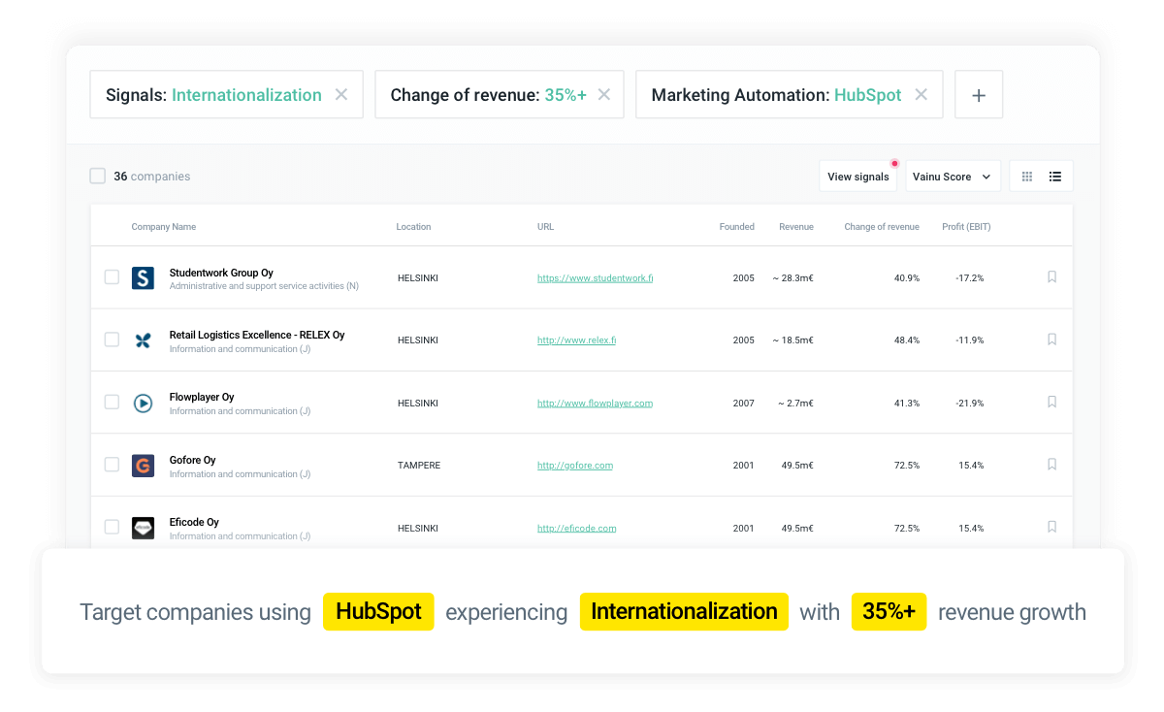
Customer segmentation
[ How do you acquire and nurture new customers?
Explain your customer segmentation strategy. ]
Micro-segments: Use the Vainu Custom Industry company property/data field to uncover unique customer segments based on the most relevant data points.
We concentrate on acquiring specific high-value customers with highly targeted, personalized campaigns.
We add companies to our account-based marketing campaigns automatically as they go through significant company changes by following trigger events.

Slide 24
Ideal timing
[ What’s the best timing to launch a new marketing campaign?
Define what kind of behaviour by a company means high buyer intent for you. ]
We launch a new campaign wherever a new company matches our ICP.
We connect our CRM and marketing automations tools with Vainu to detect high buyer intent and when an account shows such behavior, we auto-trigger a customized workflow to nurture them.

Slide 25
Content marketing strategy
[ How do you plan, produce, and manage content?
Describe the essentials of your content marketing strategy. ]
3 main objectives: a) lead generation, b) drive conversions, and c) brand awareness.
We publish a new blog post every week and a long-form content piece every quarter.
Organic search is our primary distribution channel.
Our core topics are: [ insert your pillar content ]

Slide 26
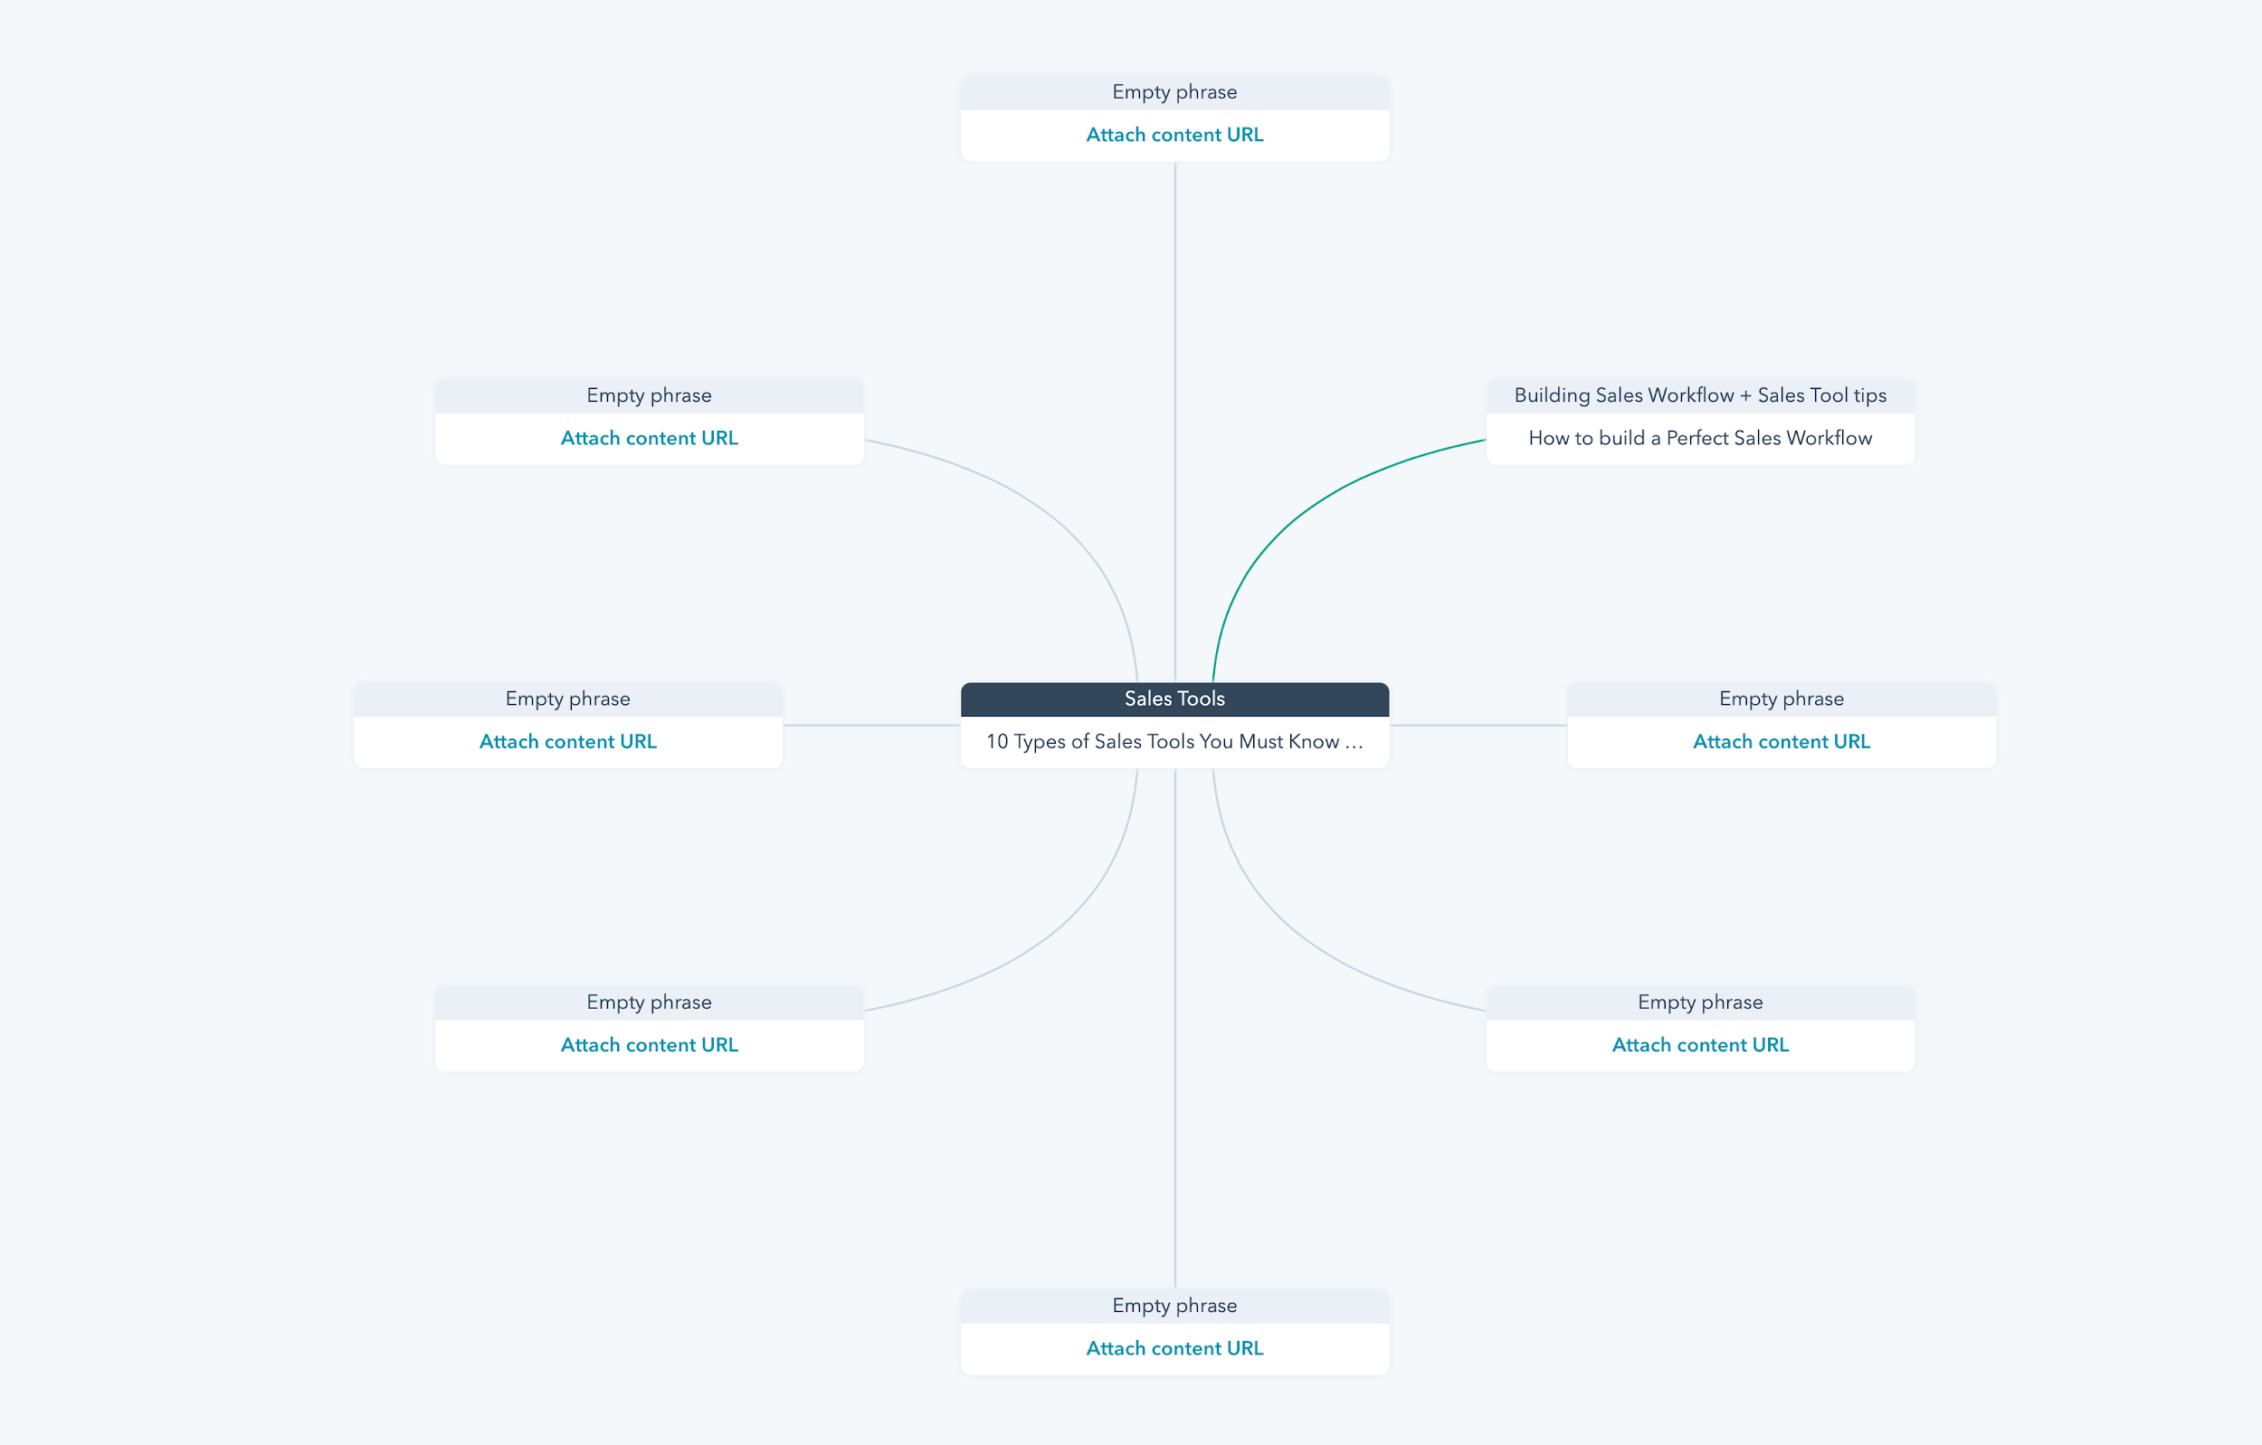
SEO
[ What’s your process of planning and implementing steps designed to improve search engine rankings?
Explain how you aim for top placement in SERPs. ]
You’ll find our list of keywords here [ insert link ].
We optimize our content for search intent to attract the right audience.
We actively search for backlink opportunities.

Slide 27
Personalization
[ What are your tactics to deliver personalized experiences?
List the tools to create tailor-made messages for your audience. ]
Behavioral data and insights from company information helps us personalize the message for the leads that matter the most.
We create different audiences based on relevant data points.

Slide 28
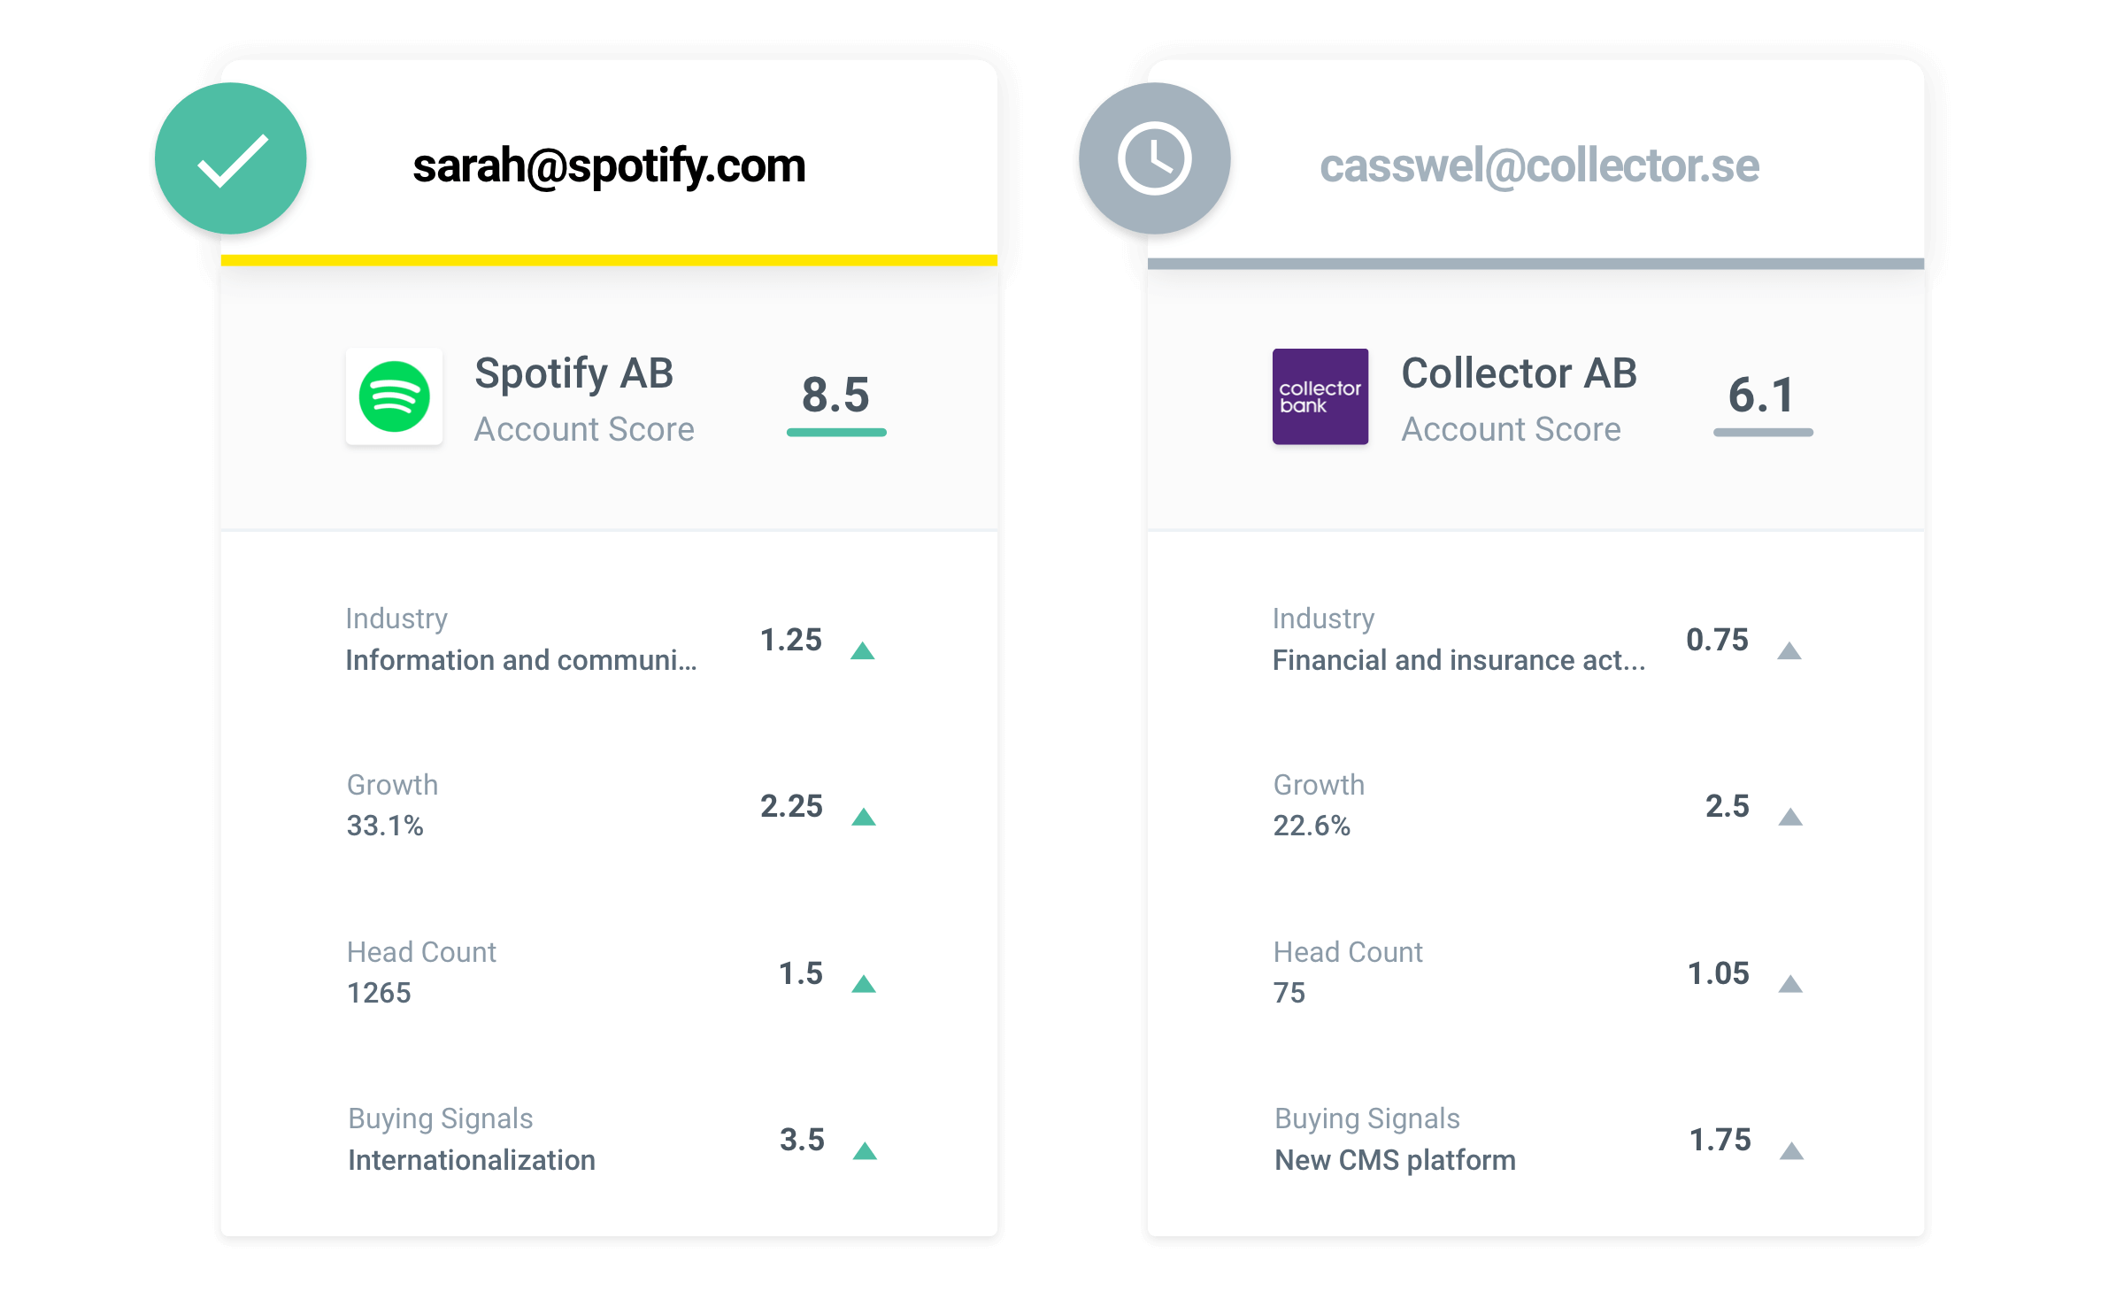
Lead management
[ How will you route leads to the sales team? How will you prioritize them?
Map out the key areas of your lead management process. ]
We enrich inbound leads with key data points from a sales intelligence platform and build rich profiles.
Company data points improve our lead scoring models and helps us prioritize.
We use real-time company information to enrich, score and qualify your leads on the basis of attributes that matter, like company size, growth rate, industry and activities that show high buyer intent.
We automatically route leads to the right reps back in our CRM by using those data points to create the right segments.

Slide 29
Targeted advertising
[ What’s your ad strategy?
Describe your tactics to get the best bang for your buck. ]
We amplify the reach of our content through ad spend.
We get in front of the companies that matter by building target lists based on very specific company attributes.
We draw insights from company information to craft relevant ads that resonate with our target audience.

Slide 30
Smarketing
Our goal at [ company name ] is 100% sales and marketing alignment.

Slide 31
Sales and marketing alignment
We’ve established a service-level agreement with the sales team.
Marketing commits to generate X number of qualified leads each month.
Handoff occurs when [ insert your criteria ]
[ How is the collaboration with your sales team? Have you established common goals?
Explain here how sales and marketing work together.
Arrange one-to-one meetings with a sales rep and encourage your new hire to join a sales call. ]

Slide 32
Resources
Sales and Marketing Intelligence blog
Real-Time Sales
Master Class
The Beginner’s Handbook to ABM
Our collection of practical tips for using real-time company data to be more relevant in sales and marketing.
https://www.vainu.com/blog
Our methodology for selling summarized in seven lessons and videos.
[ Watch ]
Get started with account-based marketing with one easy-to-read guide.
[ Read ]
Sales-marketing SLA template
Our basis for sales and marketing collaboration. Lead quality and quantity expectations.
[ Get template ]

Slide 33
Looking to supercharge your marketing with data-driven tactics?
Contact us at vainu.com to learn exactly how your team could be using real-time company information for customer segmentation, lead enrichment, personalization, and targeted ads.

