Slide 1
Sales Playbook
Template
[ Insert Company Name ]

Slide 2

Welcome!
This playbook is here to get you up to speed with working at the fast-paced, well-oiled sales machine that is [ INSERT YOUR COMPANY ].
We’ve covered all relevant topics from company to product to the actual sales and customer success processes, as well as your role and daily life in all of this.
This is not a set of rules, but rather a collection of tips, tricks, and lessons we’ve learned the hard way during our journey at the company. Take them with a grain of salt and make them your own—it’s the end result that matters.
Mikko Honkanen
CEO, Co-founder

Slide 3
Table of contents
Company overview
Our offering: Product, services, and pricing
Our methodology for selling
  Sales approach
  Ideal customer profile
  Buyer persona
  Sales key performance indicators (KPIs)
  Our tech stack
Our sales process
  From prospecting and outreach to agreement and closed deal
Additional resources

Slide 4
The company
The reason we’re all here
Company overview
Sales organization
Your role
Career path

Slide 5
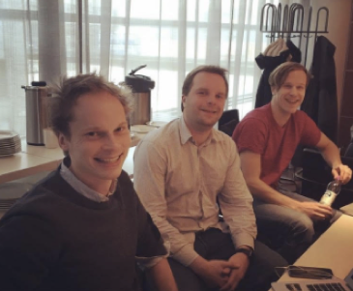

History
[ Write your company’s history. Take Vainu’s own history as an example. ]
Back in 2013, three childhood friends from Tuusula saw an opportunity in B2B sales.
What if there was a tool to help B2B salespeople use readily available data to have the right hunch (Vainu in Finnish) every time? What if they knew who to contact, when to reach out, and what to talk about?
Over time, this opportunity grew into a 120+ employee scaleup, with operations across 7 countries.

Slide 6

Mission
[ A short statement that defines what your organization is, why it exists, and its reason for being. ]
Vainu’s mission:
We provide information that moves salespeople forward.
Our ability to do so is a function of the data available, our ability to collect and transform it into useful facts, and to connect it to the business platforms our customers use.

Slide 7

Vision
[ An inspiration statement that defines the overarching objective or goal of your company. ]
We see a world where the gap between B2B sellers and buyers is closing in, through better use of available data. We’re a part of this change, bringing this data to our customers—leading to measurable business results.
Our vision highlights this belief:
We’ll create EUR 100M in cumulative revenue for our customers by 2023.

Slide 8
Values
[ Write the common values that make your company thrive. ]
We will achieve our goals by following our guiding values:
Focusing on our customers’ successes over ours’
Being fearless in how we do things,
Taking extreme ownership of our objectives (or voicing our opinion if we don’t agree), and
Showing respect and humility to those around us.

Slide 9
Our sales organization
[ Insert organizational chart. ]
New Business
Team members
Role of the department
Client Success
Team members
Role of the department
Client Development
Team members
Role of the department
Marketing department

Slide 10
Your role
[ Write the job description of a sales representative at your company. This will set clear responsibilities and goals. For example, the below describes the role of a Sales Manager at Vainu. ]
You’ll sell to sales and marketing leadership in companies that belong to our ideal customer profile.
You’ll build your own pipeline, and have sole responsibility of your own sales targets.
You will have at least 20 meetings with different companies in a month, with an average sales cycle of 30 days.

Slide 11
Career path
[ Career development is important for keeping the team motivated and retaining talent. Write here a successful career path at your company. ]
Account Manager
Ideal for…
Required skills
Timeline:
Key Account Manager
Ideal for…
Required skills
Timeline:
Team Lead
Ideal for…
Required skills
Timeline:

Slide 12
Our offering
Product
Services
Pricing

Slide 13
Our offering
[ Describe your offering, your product’s features, and your unique selling points. Your sales reps must know your offering inside out. ]
Vainu’s real-time company data platform collects available information from open and public sources, transforms this raw data into meaningful company facts, and connects the data to our customers’ business systems.
180M+
195
400K+
  30
Companies in
the database
Unique data points
Daily processed news articles
Days to refresh entire DB

Slide 14
Our services
Onboarding
Implementation and training to ensure our customers get up and running with the platform as quickly and smoothly as possible.
Split into standard and premium onboarding depending on the complexity of the customer organization’s needs.
[ Describe additional services and up-sell opportunities. ]
Professional services
Additional services for purchase throughout the contract period to get even more out of your product’s experience.
These include workshop facilitation, data or technical consultation, and sales training.

Slide 15
Pricing
[ Include a breakdown of your pricing scheme. ]

Slide 16
Our sales methodology
Real-time sales and marketing
Sales methodology
Ideal customer profile
Buyer personas
Trigger-based sales
Key performance indicators
Our tech stack

Slide 17
Real-time sales and marketing
[ At Vainu, this is our methodology for sales. Explain here what makes your approach to sales unique. ]
There’s more data out there than ever before—according to Forbes, more than 90% was created in the last two years alone. Yet while some industries already use data to their advantage, not in B2B. Cold calling through random lists and spamming emails without targeting are still seen as viable tactics.
We believe there’s a better way: One where you carry out personalized conversations at scale, using real-time company information in every customer interaction.
This is what we call real-time sales and marketing.

Slide 18
Sales code of ethics
[ A set of rules to guide us towards the things that matter on the long run. ]
In addition to looking at the numbers, we also focus on doing what’s right. In B2B sales, we believe there’s a right way (and a wrong way) of doing things, and so we wrote our own sales code to summarize how we believe things should be done.
Read it here [ Insert link ].
“We aim to impress. We’re deliberate in planning how we book a meeting, run a demo, send a proposal and interact with a customer, and it shows in our delivery.”

Slide 19

Ideal customer profile (ICP)
[ A description of a fictitious account. Your dream, perfect-fit customer. ]
Over the years, we’ve noticed that our best customers, i.e. the ones who see the most benefit from our platform and stick with us, have a common trait. We’ve decided to only sell to those who fit that criterion.

Slide 20



Buyer personas
[ A detailed analysis of the people who buy from you. ]
Within our ICP, we’ve identified these ideal buyer personas: people whose needs our solutions best solve.
Buyer persona 1
Buyer persona 2
Buyer persona 3

Slide 21
Persona:
Persona: SMB to Mid-market,
reports to the CEO
Goals: Increase sales, prevent churn,
manage the sales team
Challenges: Motivate the sales team, find
leads, speed up the sales cycle
Sales Director,
VP of Sales

Slide 22
Persona: Marketing Lead
Persona: Mid-market to enterprise,
Part of the executive team
Goals: Deliver highly converting leads
to the sales team
Challenges: Sales and marketing alignment,
data quality, lead conversions
Chief Marketing Officer, CRO

Slide 23
Persona: Data Lead
Persona: Enterprise
Approves data decisions
Goals: Improving processes, driving
efficiency, security and compliance
Challenges: Data accuracy, data
management, data flow
Head of IT / Operations / CRM / Analytics

Slide 24
Key performance indicators (KPIs)
As in any sales role, the key metric is how much business you’re bringing in. To be successful in the role, you should be bringing in a minimum of [ Insert target ] monthly in new business.
The easiest way to achieve this goal is by being active. The minimum standard of activity is [ Insert target ]—whether that’s online or in person, discovery or demo, doesn’t matter. But we expect you to hit it, every single week.
KPIs we track
These are supporting numbers we report in our weekly meetings:
Discovery meetings held
Demo meetings held
Upcoming meetings in the next 14 days
Sales forecast for the month
Pipeline for next month

Slide 25






Our tech stack
We use a modern stack of digital tools to make sure we’re efficient throughout the process. Here are your daily workhorses:
Our sales intelligence tool—how we know who to target and when.
Our marketing automation platform—where we attract and nurture inbound leads.
Our online meeting tool—how we present our offering remotely.
Our CRM—where we track our sales and store our data.
Our e-signature platform—where all the deals get signed.
Our communications tool—where we interact with each other.

Slide 26
Our CRM
[ Describe best practices and rules. ]
Our CRM platform [ Insert CRM ] is the backbone of our sales process, and the data it contains, our most valuable asset.
We expect you to adhere to our rules and best practice to maintain healthy contact data.
CRM best practices
These rules helps us keep a tidy database:
Always add a contact person
Don’t forget to update pipeline stage
Use our standard nomenclature and vocabulary
Fill in all mandatory fields
Rely on the automations

Slide 27
A week at [ company name ]
[ Creating routines allows your team members to maximize their opportunities for success. List all your daily or weekly routines here. ]
Monday: Team meeting
Tuesday: Sales training workshop
Wednesday: Meeting booking power hour
Thursday: Team meeting
Friday: Weekly sales wrap up

Slide 28
Sales Process
How we acquire customers
Prospecting
Outreach
Discovery
Needs analysis
Demo
Proposal
Agreement

Slide 29






Process
[ This is your routine to optimize sales efficiency. Summarize the steps of your sales process. ]
In our sales approach, we follow a simple six-step process, systematically and diligently. Here are those steps: routine created to optimize sales efficiency
Prospecting
Outreach
Discovery
Demo
Proposal
Offer
Identifying companies that fit our segment and ICP.
Reaching out to prospects and reacting to inbound and outbound trigger events.
Running first meetings to explain what Vainu does, qualify the prospect, and understand how we can help.
Running follow-up meetings to showcase the value of our solution for the customer in practice.
Scoping out a solution with the customer and helping them through the decision process.
Documenting and signing a formal agreement.

Slide 30
Prospecting
[ How will you find potential customers?
Describe your strategy to find companies interested in the products and services you're offering. ]
Named accounts are your ideal prospects—the ones you’ve identified yourself as the the top 100 companies most likely to be interested in our offering in terms of company fit.
Unlike any other prospect, you should be especially active with your named accounts. Be sure to reach out every quarter to check in—after all, you do believe we’d be the perfect match.
Keep these named accounts under your name in the CRM platform, and add and remove companies as you see fit. But remember, only the 100 best accounts!

Slide 31
Outreach
Once we know who we want to sell to, it’s time for outreach. To make sure we actually get a hold of the people we’re targeting, we stick to a routine cadence when reaching out.
The cadence is a combination of different outreach tactics repeated for each prospect in a systematic way. This gives us the best chance to get our message in front of the buyers.
In this step of the process, gather in-depth information on your prospects in order to prepare your pitch and personalize your outreach.
[ Describe your outreach strategy. When is a the right time to pick up the phone and call?
Include several examples of your sales pitch and collateral. ]

Slide 32
Sales cadence
Day
1
Email > Voicemail
Day
2
Phone > Social
[ Define the number of touches over a period of time to illustrate the typical sales cadence at your company. ]
Day
3
Phone > Voicemail
Day
4
Email
Day
5
Email / Social

Slide 33
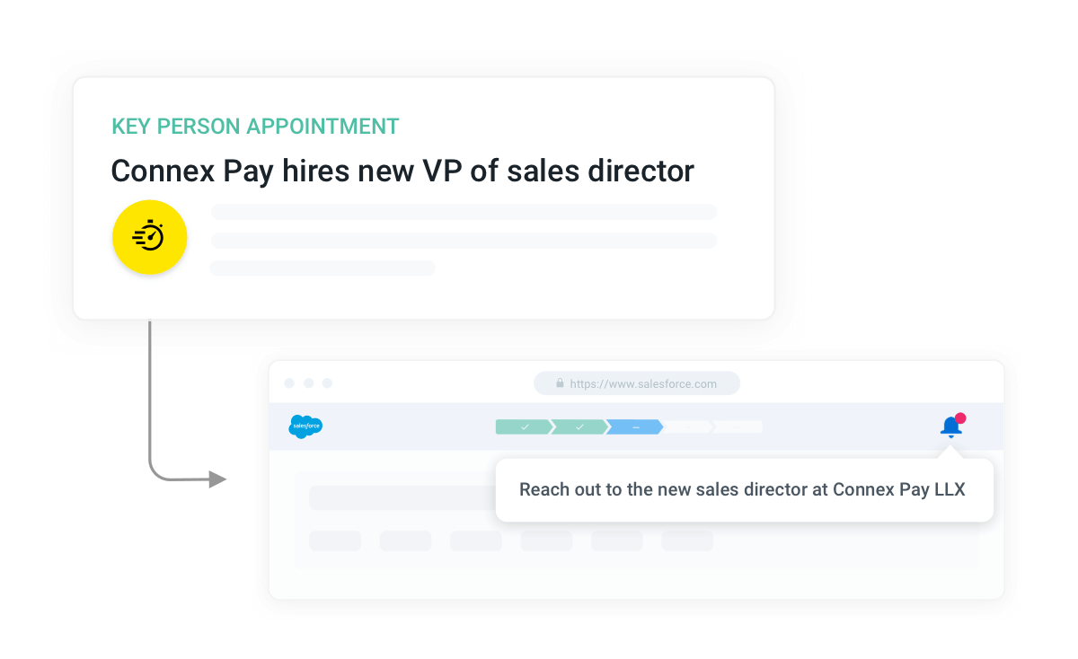
Trigger-based sales
Once you know your target market, knowing which accounts to prioritize comes next. In sales, timing is everything.
We believe in acting based on triggers: moments in a company’s lifecycle that suggest they are more interested in what we have to offer.
You’ll be looking for sales trigger events within ICP accounts to help focus your sales efforts on the right ones.

Slide 34
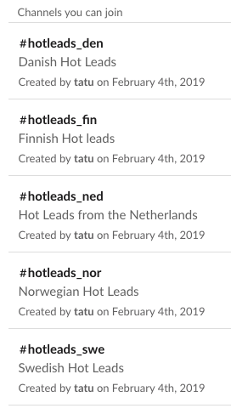
Inbound trigger events
Inbound trigger events come from someone interacting with our content on our website. These can be divided into demo requests (or SQLs), i.e. someone asking for a demo deliberately, or hot leads (MQLs), where they left their contact details and, based on our data, seem especially interested in our offering.
You’ll get notified on inbounds via slack. And as they’re reaching out to us, note that speed is key!
Once notified, view further details under
[ your marketing platform ], and the [ your CRM’s ] marketing pipeline.

Slide 35
Outbound trigger events
While inbound triggers focus on interactions with us, outbound trigger events look at changes happening on the company’s end.
It’s simple, really: certain changes make it more likely a company will have a need for sales tools like ours. And any time one of those changes happen within our ICP, we want to reach out as soon as possible.
Here are the four key changes we look to find and act upon:
Changes in sales leadership
Hiring salespeople
Growth signals (funding, expansion)
New relevant technologies
(CRM, marketing automation)

Slide 36

Using content
Over the years, we’ve created a lot of content—hundreds of blog posts, dozens of downloadable templates—to share practical tips on using data in the sales process successfully.
In addition to tailoring your pitch, be sure to use incorporate these content pieces into your cadence to provide even more value to your prospects. Tailor the pieces you use depending on the prospect’s situation at hand.
Not sure what to use? See our content mapping here [ Insert link ].
Outreach

Slide 37

Tailored pitching
For all the outreach you make, whether it’s a named account or trigger-based, you’ll automatically have a reason to be contacting them. Be sure to present that reason in your sales pitch—it’ll make them take your meeting suggestion more seriously.
You should be doing this for every pitch you make!
“Hi Jim!
I’m calling because we here at Vainu have tailored a solution specifically for sales teams using HubSpot as their CRM...
...I’ve been following your company for quite some time and noticed that you’ve recently expanded to Norway, congratulations!...
...Would you be interested in a meeting to discuss how to use real-time company data successfully in your expansion?...

Slide 38

Subject: “The first 100 days of a new Sales Director”
Congrats on the new role!
I’ve followed Company X for a while and noticed that you’ve recently started as the Sales/Marketing Director. I tried calling you earlier to arrange a meeting, as we’ve made a service tailored for your situation.
We’ve met thousands of Sales/Marketing Directors during the past five years, and know the first 90 days in the role are critical in leaving a lasting impact. Here are a couple of resources we’ve created to help you get going:
The Sales Playbook - structure to build your own “way of working” for your sales team:
https://www.vainu.com/blog/sales-playbook/
Best Sales Tools in 2020 - list of different sales and marketing tools to help you to build your own toolbox:
https://www.vainu.com/resources/ebook/sales-tools/
I’d love to discuss your situation further and highlight how we could help you leave an impact through better use of data at Company X. Are you available for a quick call tomorrow?

Slide 39
Discovery
[ Your sales reps need to understand your prospects to be relevant. Explain here how they will develop an understanding of prospects’ needs and pain points. ]
In the first meeting, our purpose is for the customer to understand your company’s offering on a high level, and determine on a practical level whether there is any value to them from our platform.
From a sales perspective, we aim to understand how the prospect does business, and link our offering to practical use cases they would see value in.
Meeting structure (45min)
Here’s the structure to follow in these meetings:
Introductions (5min)
Sales deck (10min)
Needs analysis (15min)
Identifying use cases (10min)
Next steps (5min)

Slide 40
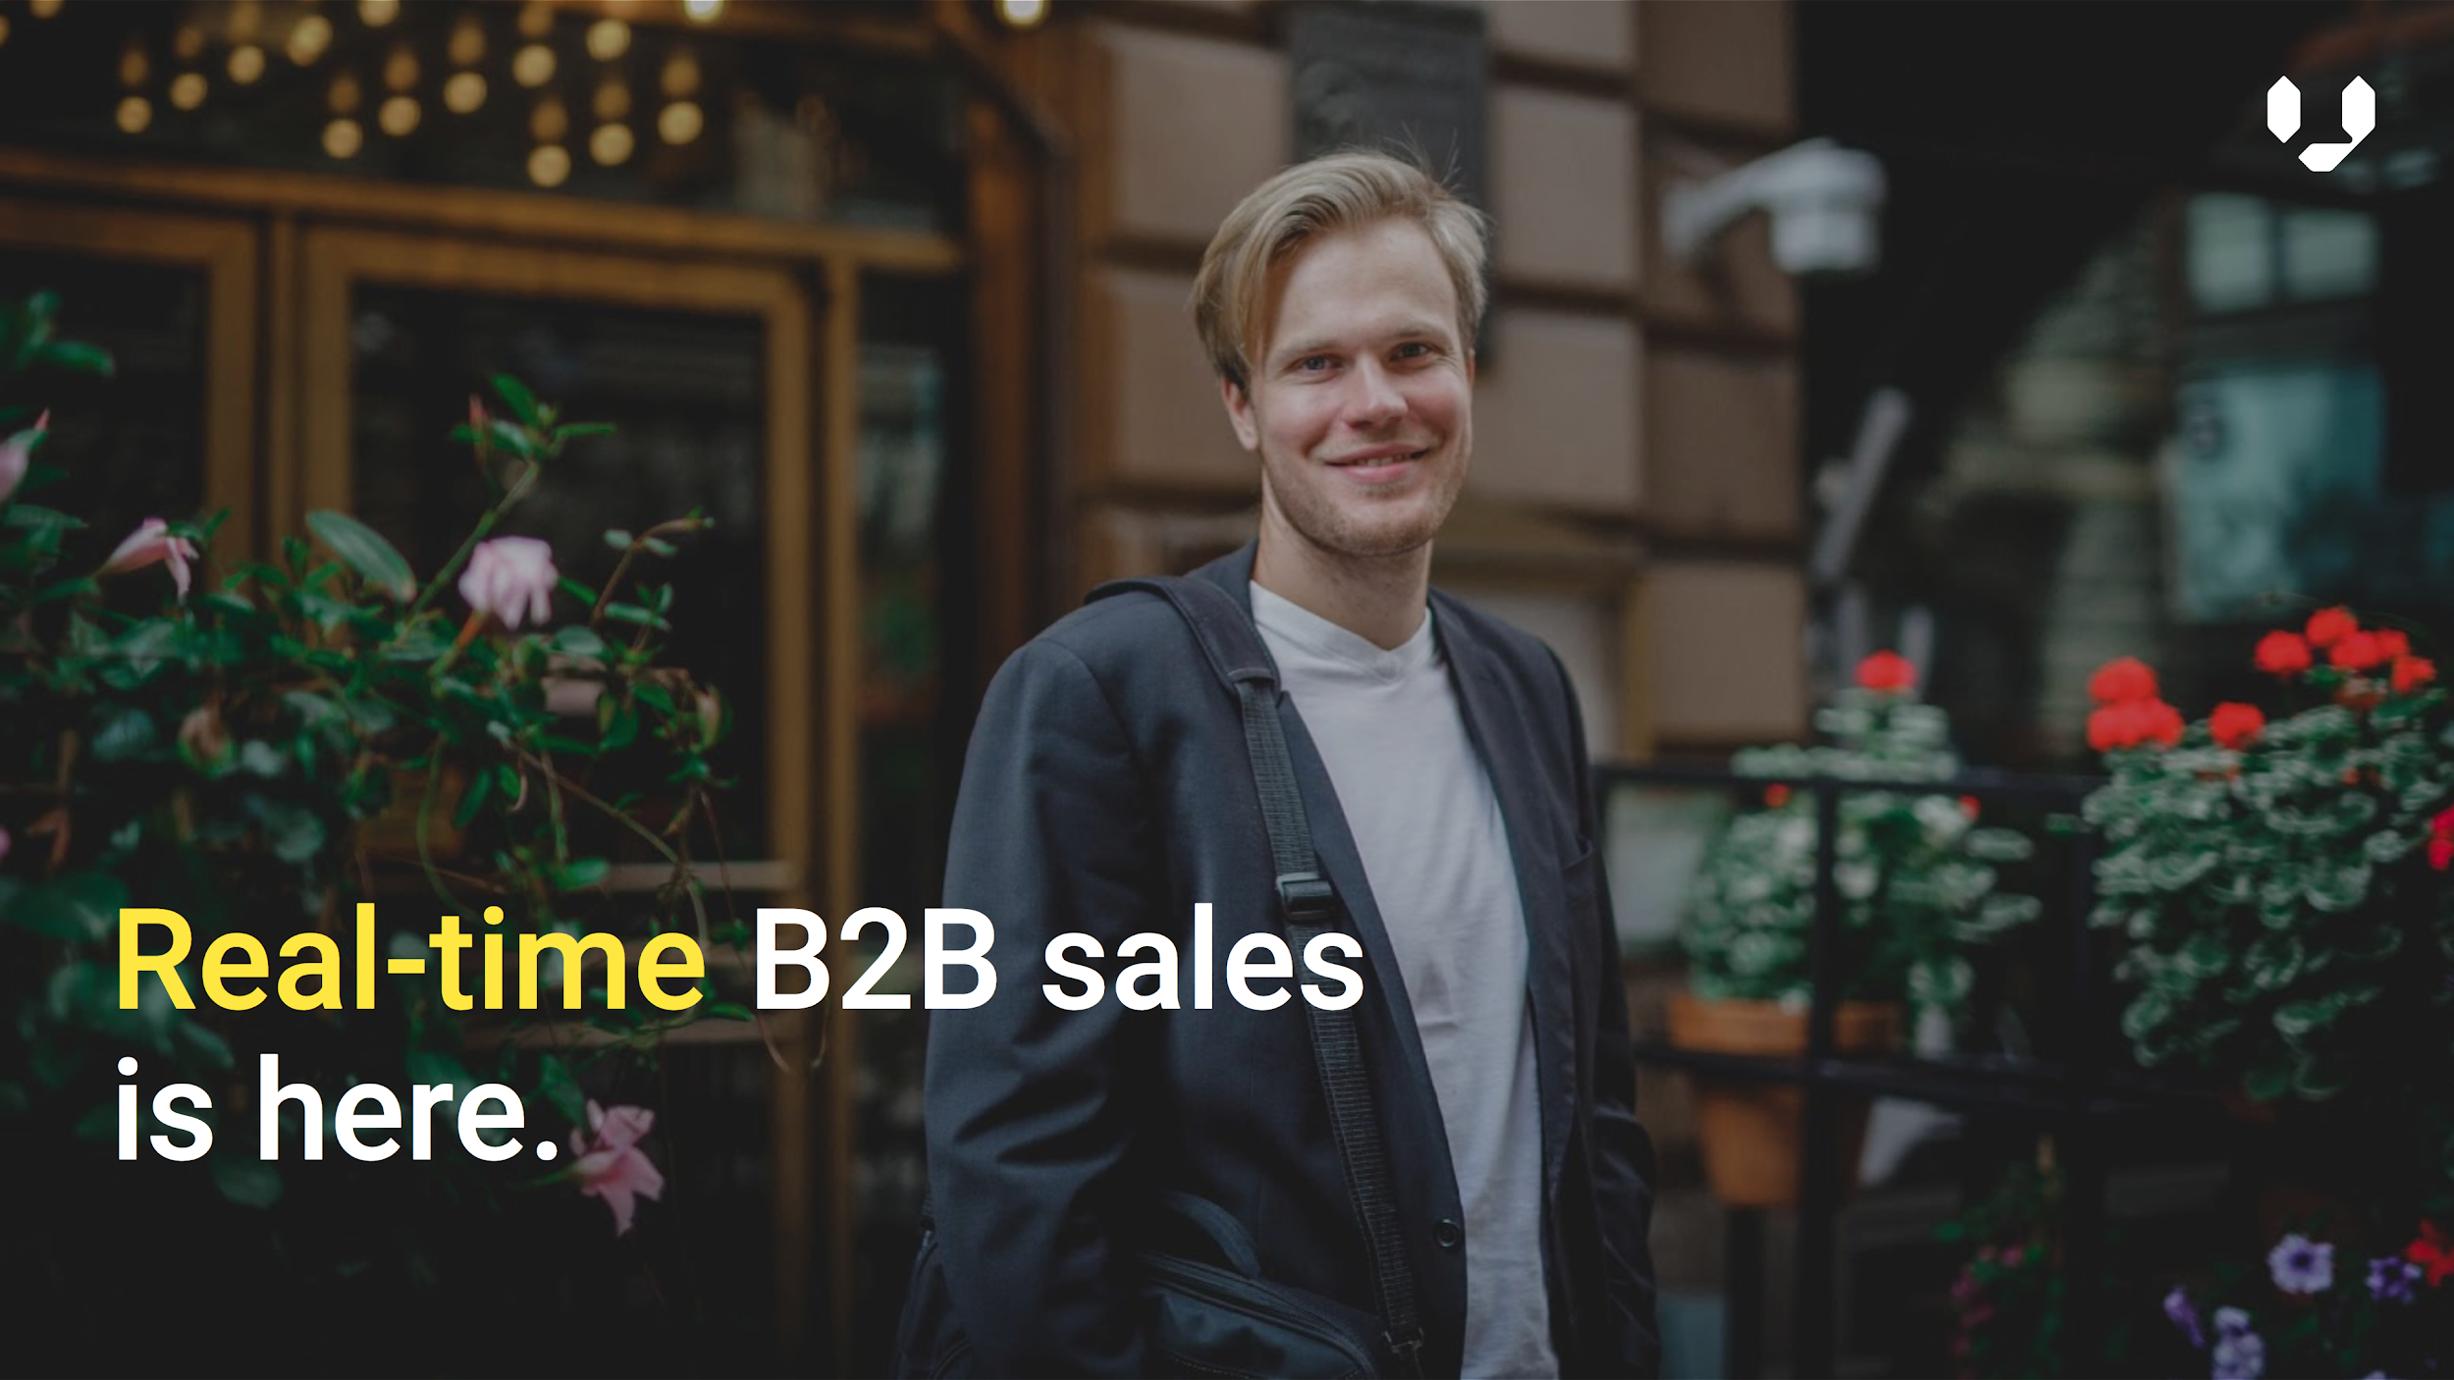
Sales deck
In the first meeting, after introductions, present your sales deck to the prospect. The key is to present why your company exists, and what this could mean for your prospect.
Be sure to learn how to present with the slides together with your team!
[ Include here a link to to your sales deck ]

Slide 41
Needs analysis
Business: What does the prospect company do?
What do their customers look like?
Challenges: What are the business objectives?
What challenges have they been facing?
What strategic projects are going on?
During and after your presentation, you should be engaging with your prospect to gain an understanding for how they run their business, and how we could help. At minimum, try to get an understanding for the topics listed here—through natural conversation, of course. No one likes being interrogated!

Slide 42
Demo
[ Explain here how you run product demos. Below is our approach to demos at Vainu and their objectives. ]
In our follow-up meeting, the objective is for the customer to understand in practice what company data is relevant for their customer acquisition process, where and how it would best be consumed by the team in order to be as efficient as possible, and understand the tangible value of Vainu’s platform in this.
From a sales perspective, we aim to understand what solution with our platform would be feasible, match the customers’ needs, and provide the most value.
Meeting structure (1h30min)
Here’s the structure to follow in these meetings:
[ Write your standard meeting agenda ]
Introductions (5min)
Recap from the previous session (10min)
Customer profiling workshop (20min)
Trigger events workshop (20min)
Product demonstration (20min)
Discussion and next steps (15min)

Slide 43
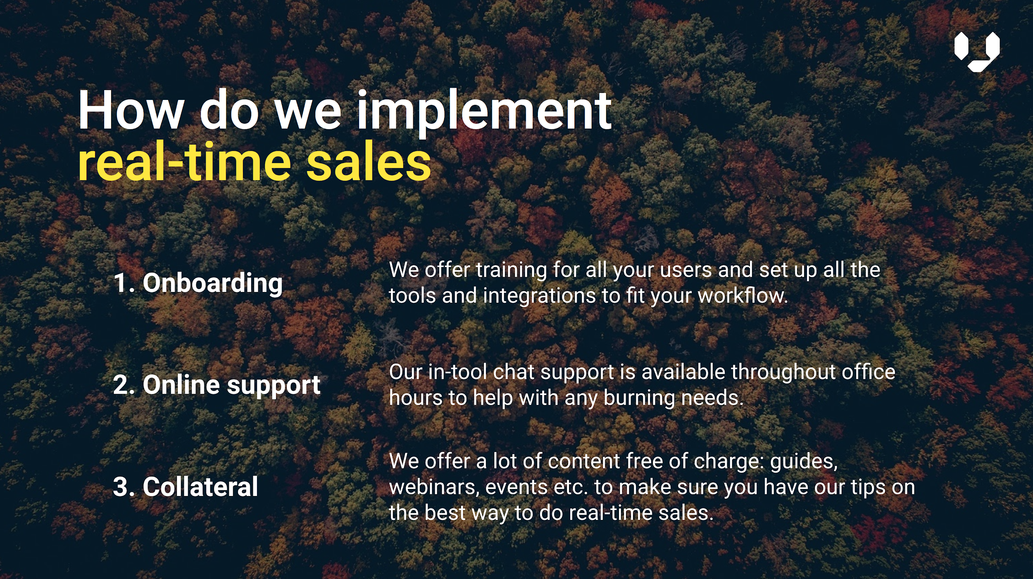
Proposal deck
You had the meetings, you demoed the product, and everything is all fine and well. They’re interested. It’s now time to talk business. The first step: a formal proposal.
You’ll find our proposal template [ insert link here]. Adapt it to the situation at hand—everything you discussed with the prospect should be covered. Customer challenges, product use cases, key data points, implementation, pricing, received value. The cleaner it is, the easier for the customer to say yes to it.

Slide 44
Agreement
They said yes! Time to turn our proposal into a formal agreement.
You’ll find our contract templates here
[ insert link ]—just fill in the details to the placeholders in yellow, and you’re good to go.
If there are any exceptions required on the customer’s end, be sure to check if its feasibility with Sales Operations before agreeing.
Once you’ve agreed to the terms, send the contract out for signature via [ insert your e-signature software ]. It’s as easy as 1-2-3.

Slide 45
Signed and filed!
Congratulations! You’ll get automatically notified on all closed deals through our dedicated slack channel. Share a brief summary on the case for others to learn from.
Once they’ve signed be sure to mark the deal as Won in [ Your CRM ].
Finally, introduce the Customer Success rep to the decision-maker, and you’re good to go!

Slide 46
Resources
Sales intelligence blog
Resource center
Our collection of practical tips for using real-time company data to be more relevant in sales. Filter by topic to find what you’re looking for.
https://www.vainu.com/blog
Our collection of downloadable templates, ebooks, and webinars to help support your journey as a real-time sales specialist.
https://www.vainu.com/resources

